Slide 1
Api Gateway
OW

Slide 2

What is API?
APIs (Application Programming Interface) are mechanisms that enable two software components to communicate with each other using a set of definitions and protocols.
Basically, APIs are a way for applications to communicate with each other across the web through specific inputs and outputs.
For example, the weather bureau’s software system contains daily weather data. The weather app on your phone “talks” to this system via APIs and shows you daily weather updates on your phone

Slide 3
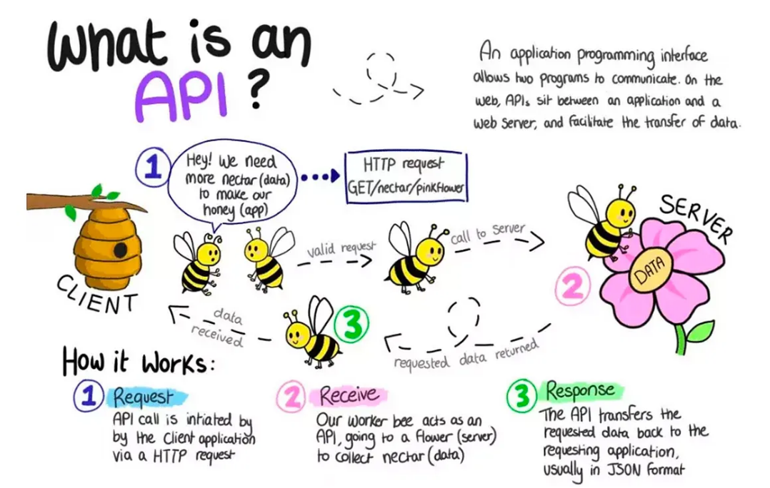
..

Slide 4
What is API Gateway?
Amazon API Gateway is an AWS service for creating, publishing, maintaining, monitoring, and securing REST, HTTP, and WebSocket APIs at any scale.
It enables real-time two-way communication applications. API Gateway supports containerized and serverless workloads, as well as web applications. API Gateway handles all the tasks involved in accepting and processing up to hundreds of thousands of concurrent API calls

Slide 5
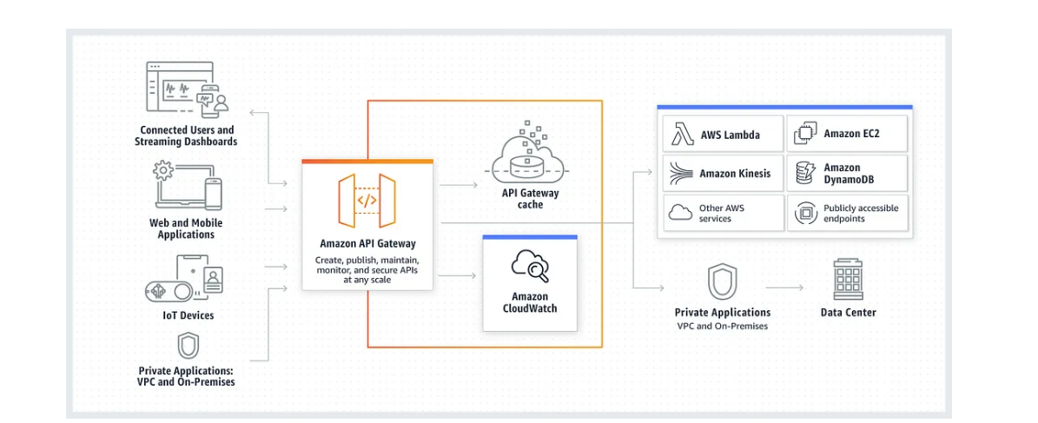
API Gateway Architecture

Slide 6
..
This diagram illustrates how the APIs you build in Amazon API Gateway provide you or your developer customers with an integrated and consistent developer experience for building AWS serverless applications.
API Gateway handles all the tasks involved in accepting and processing up to hundreds of thousands of concurrent API calls. These tasks include traffic management, authorization and access control, monitoring, and API version management.

Slide 7
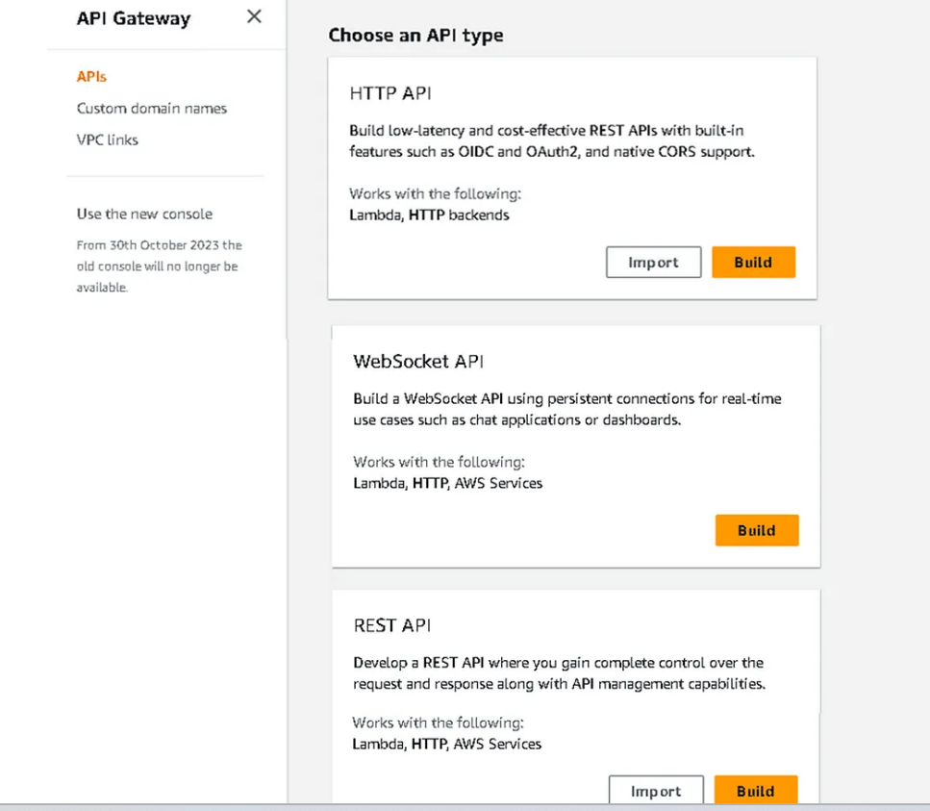
Types of API

Slide 8
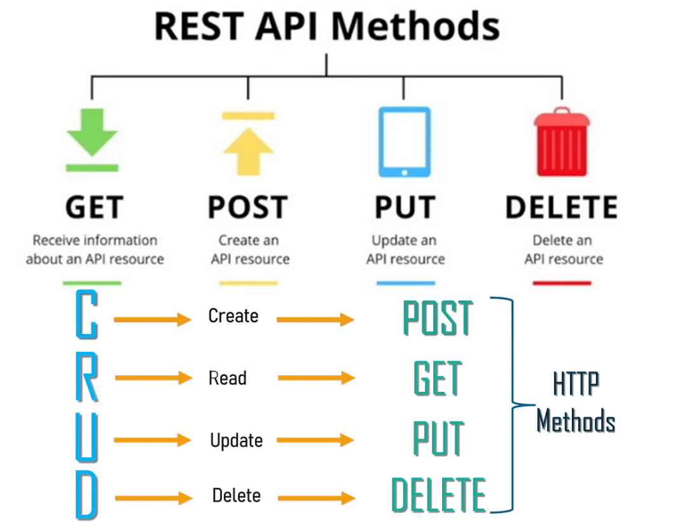
Rest API

Slide 9
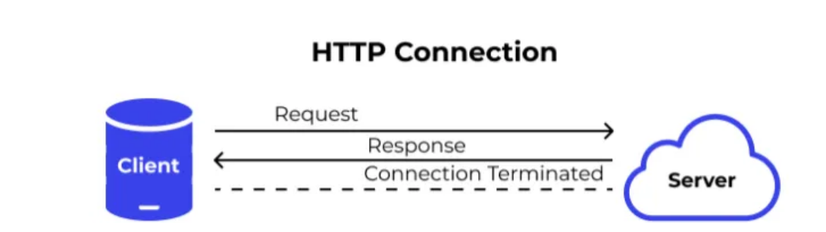
HTTP
Let’s take an example when a user sends a request to the server this request goes in the form of HTTP or HTTPS, and after receiving a request server sends the response to the client, each request is associated with a corresponding response, and after sending the response the connection gets closed

Slide 10
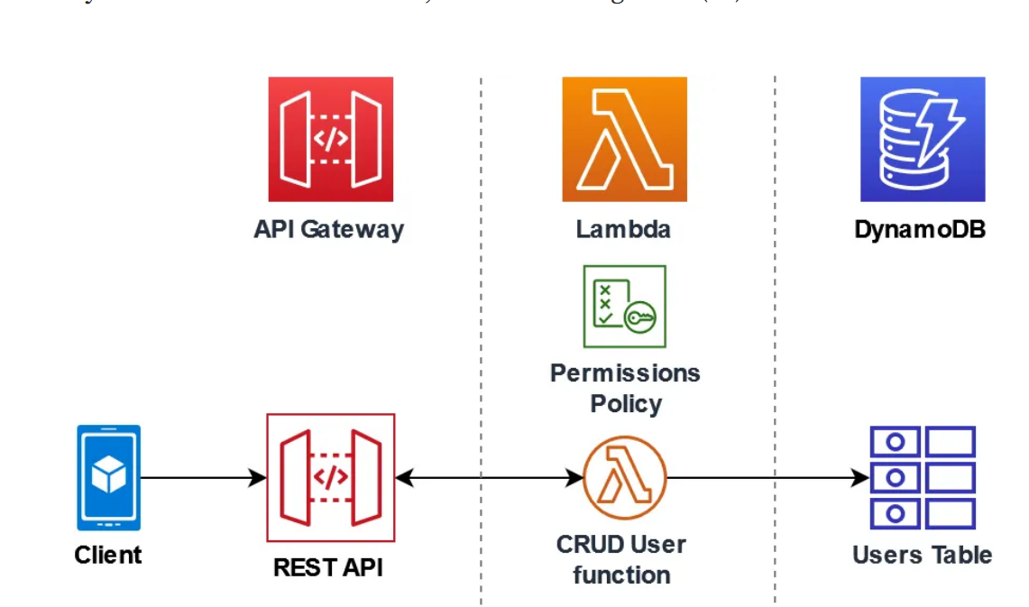
How it works

Slide 11
..
Instagram API permits your applications to retrieve user tags, photos, account, and much more.
Twitter also provides a REST API which a developer can query to source the latest tweets, or provide a search query that will return the results in JSON format.
GitHub also offers super REST API that you can utilize to perform actions such as following GitHub issues, tracking user activity, and creating repositories from your app

Slide 12
Pricing
With Amazon API Gateway, you only pay when your APIs are in use. There are no minimum fees or upfront commitments.
For HTTP APIs and REST APIs, you pay only for the API calls you receive and the amount of data transferred out. There are no data transfer out charges for Private APIs.
However, AWS PrivateLink charges apply when using Private APIs in API Gateway. For WebSocket APIs, you only pay when your APIs are in use based on number of messages sent and received and connection minutes

Slide 13
Labs
Api-Gateway lab with Lambda

